Slide 1
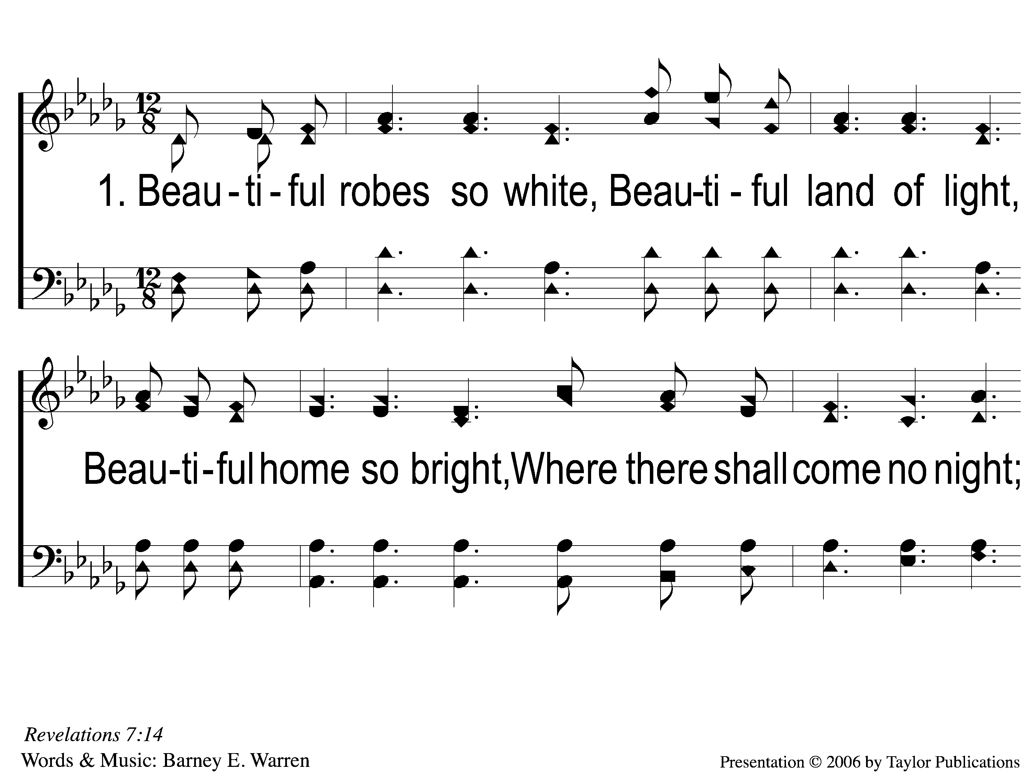
1-1 Beautiful
Beautiful
29

Slide 2
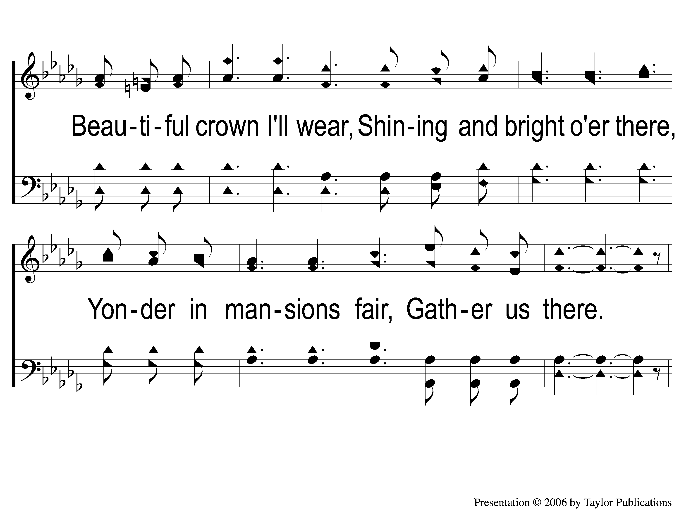
1-2 Beautiful
Beautiful
29

Slide 3
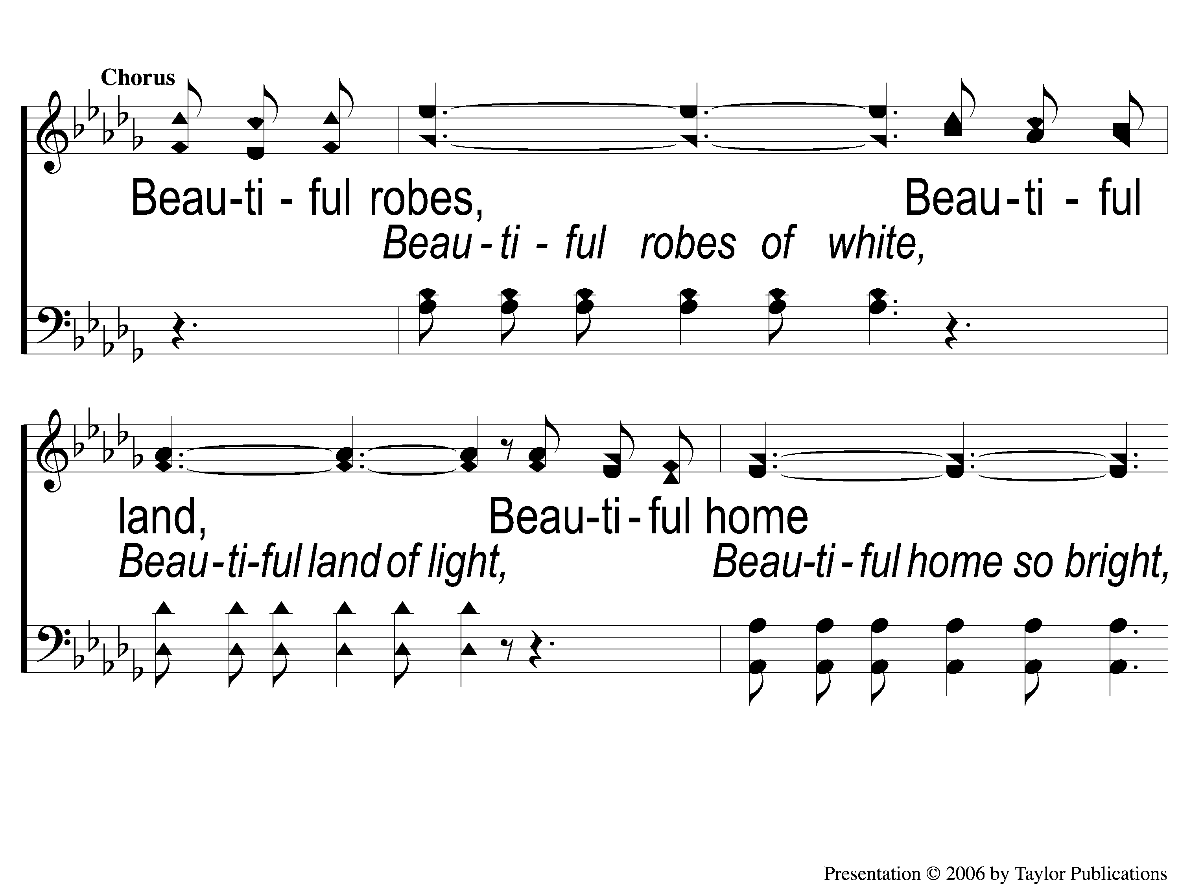
C-1 Beautiful
Beautiful
29

Slide 4
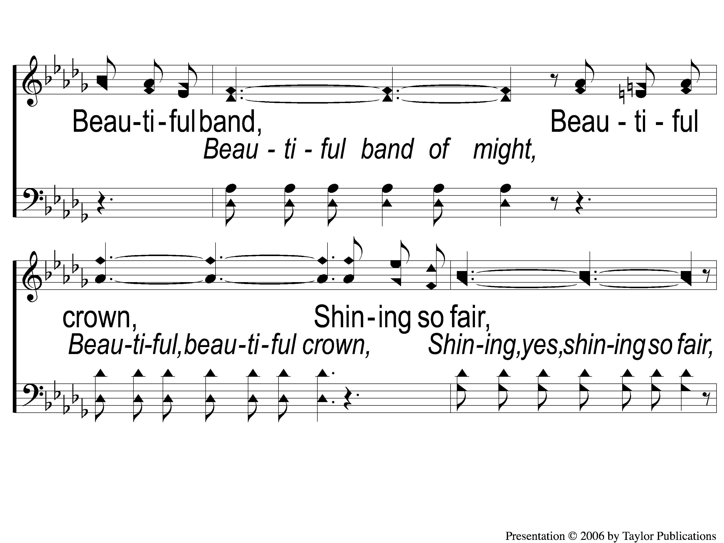
C-2 Beautiful
Beautiful
29

Slide 5
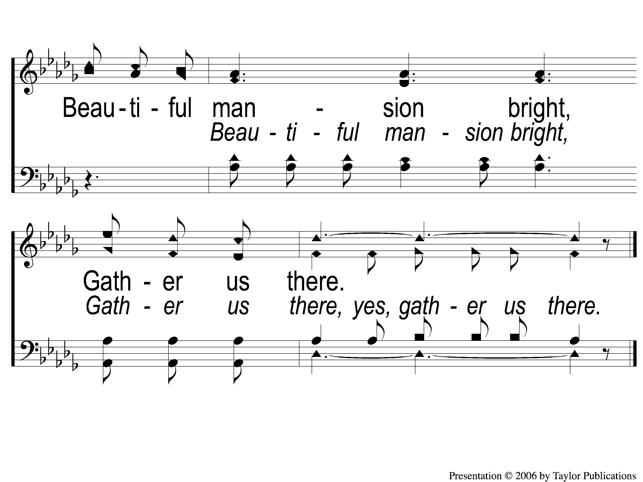
C-3 Beautiful
Beautiful
29

Slide 6
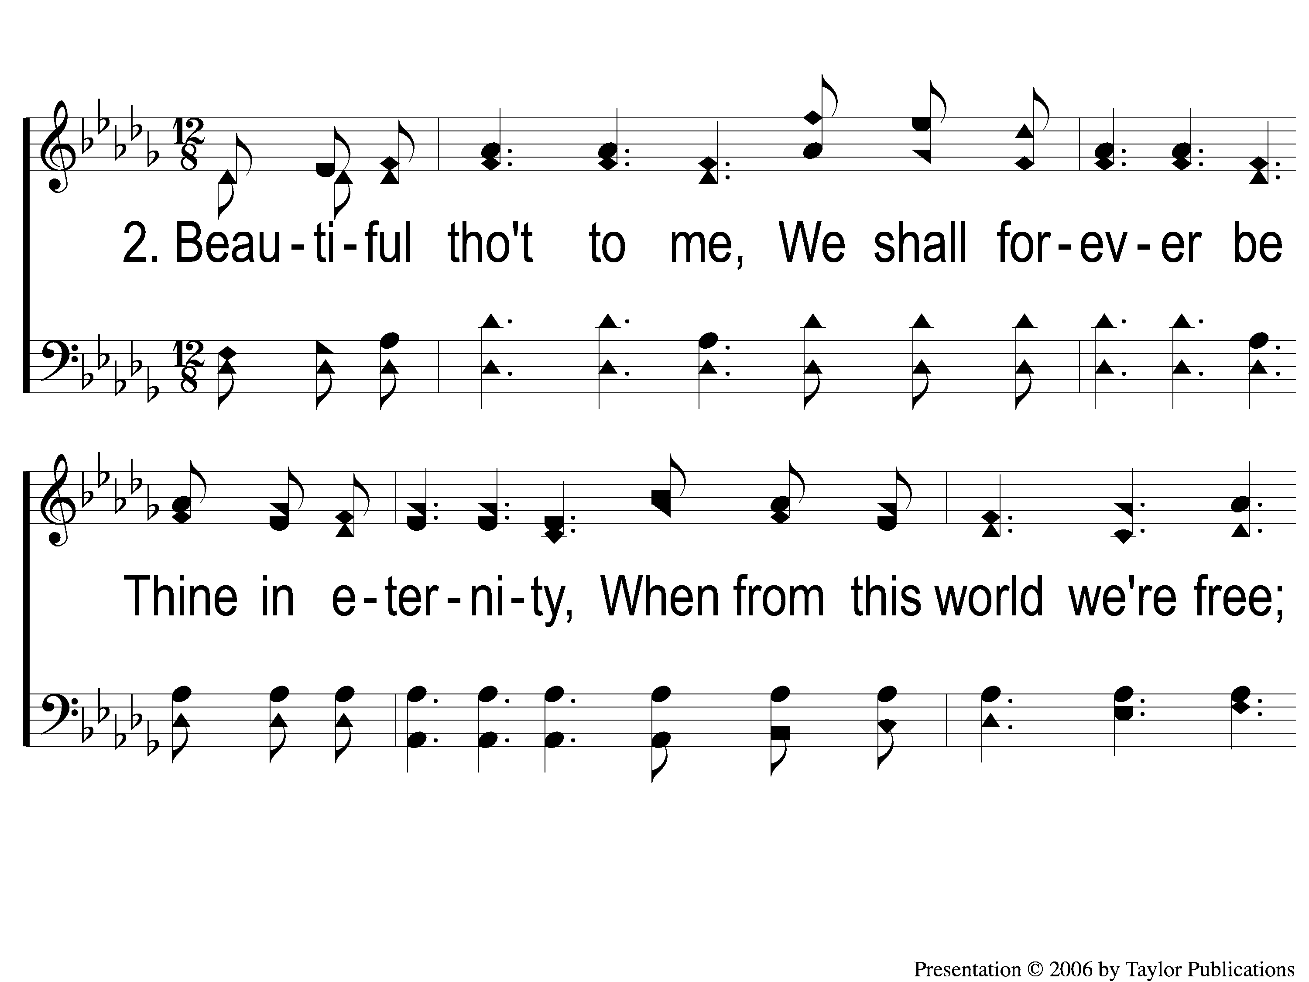
2-1 Beautiful
Beautiful
29

Slide 7
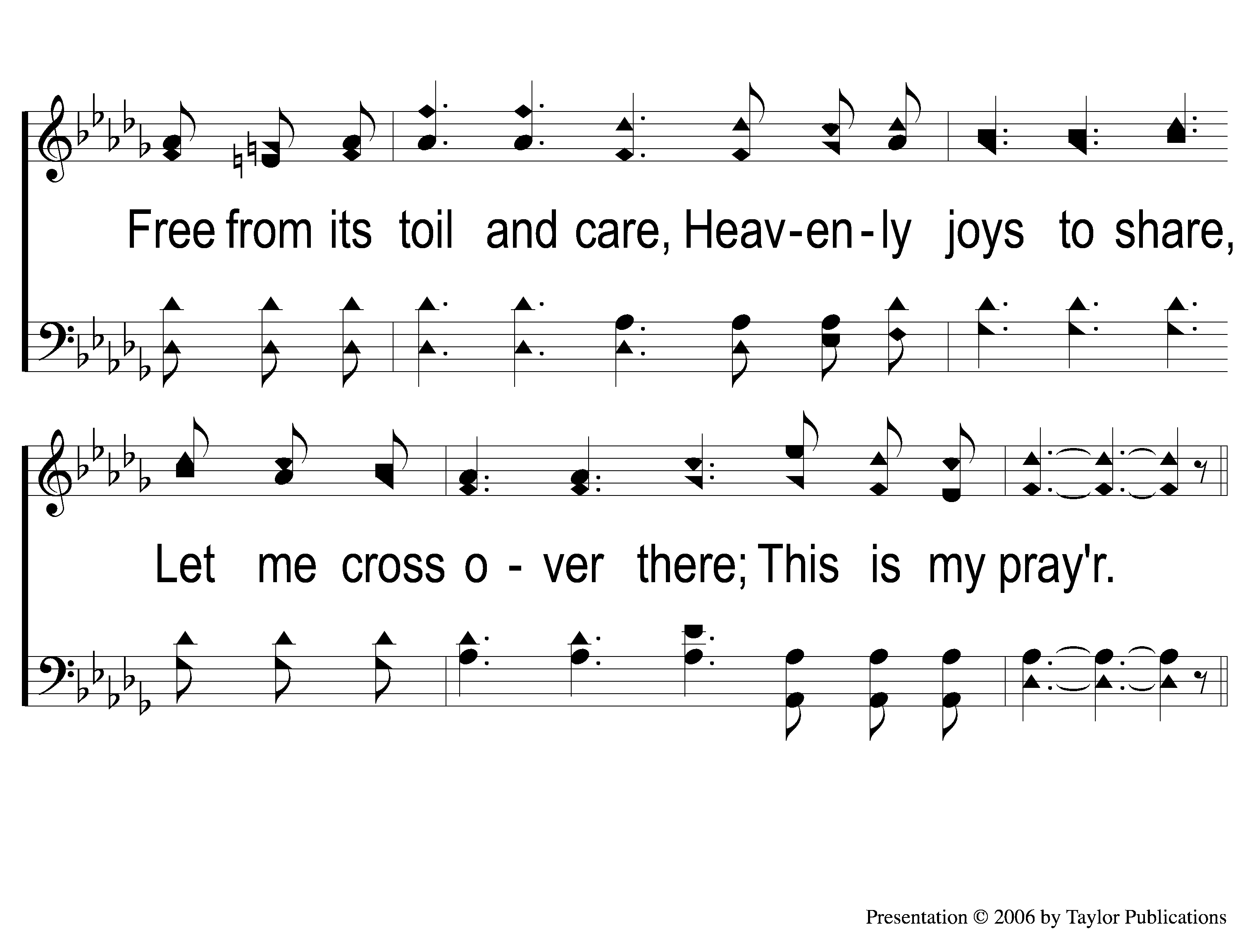
2-2 Beautiful
Beautiful
29

Slide 8
C-1 Beautiful
Beautiful
29

Slide 9
C-2 Beautiful
Beautiful
29

Slide 10
C-3 Beautiful
Beautiful
29

Slide 11
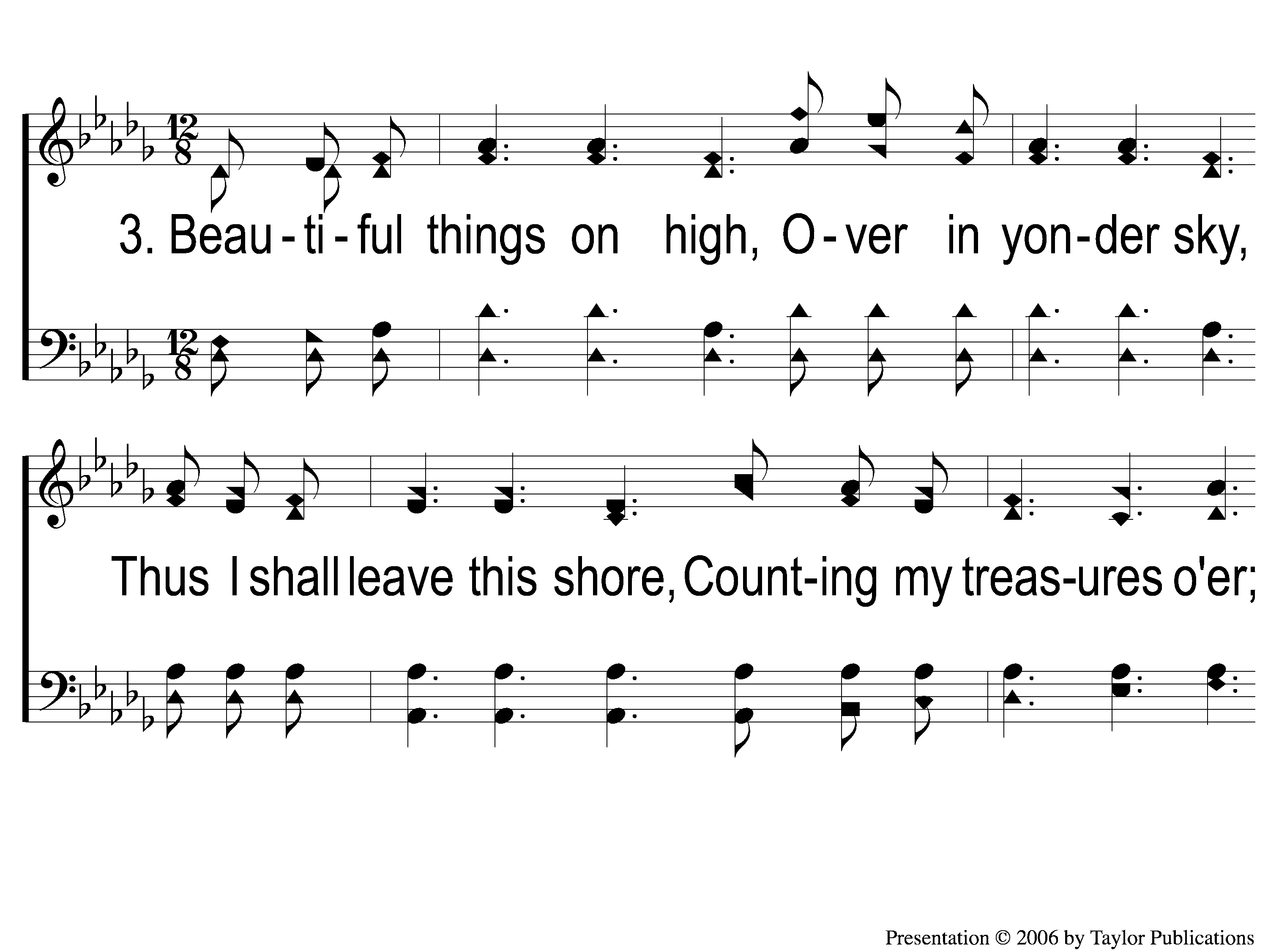
3-1 Beautiful
Beautiful
29

Slide 12
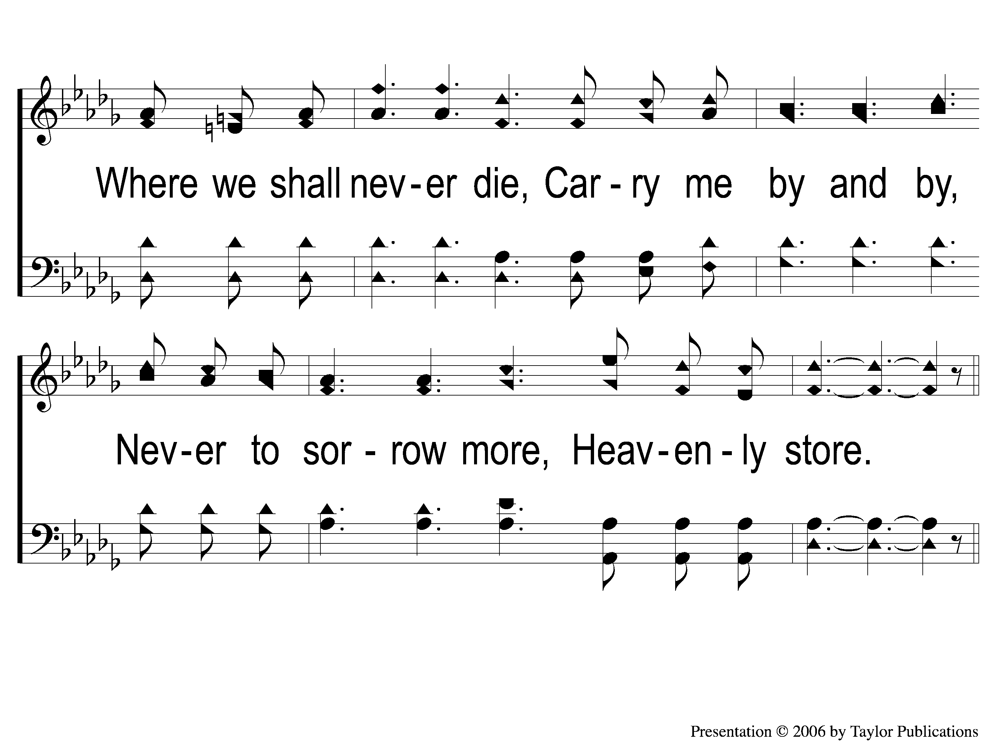
3-2 Beautiful
Beautiful
29

Slide 13
C-1 Beautiful
Beautiful
29

Slide 14
C-2 Beautiful
Beautiful
29

Slide 15
C-3 Beautiful
Beautiful
29

